Slide 1

Week 10 Data Visualization
Shaquiel Pashtunyar
DSC640

Slide 2
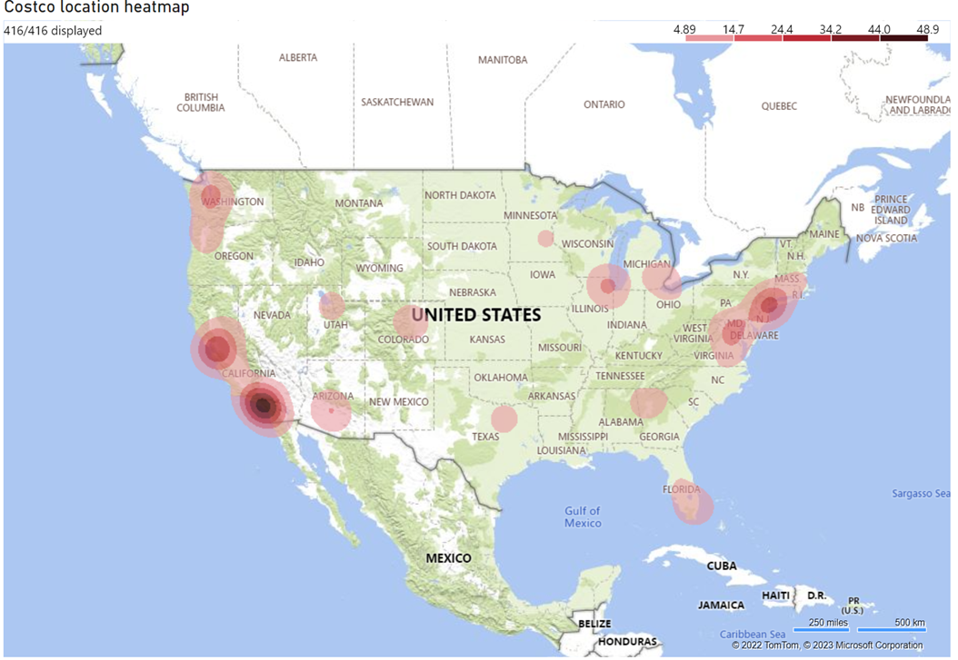
Power BI Heat Map

Slide 3
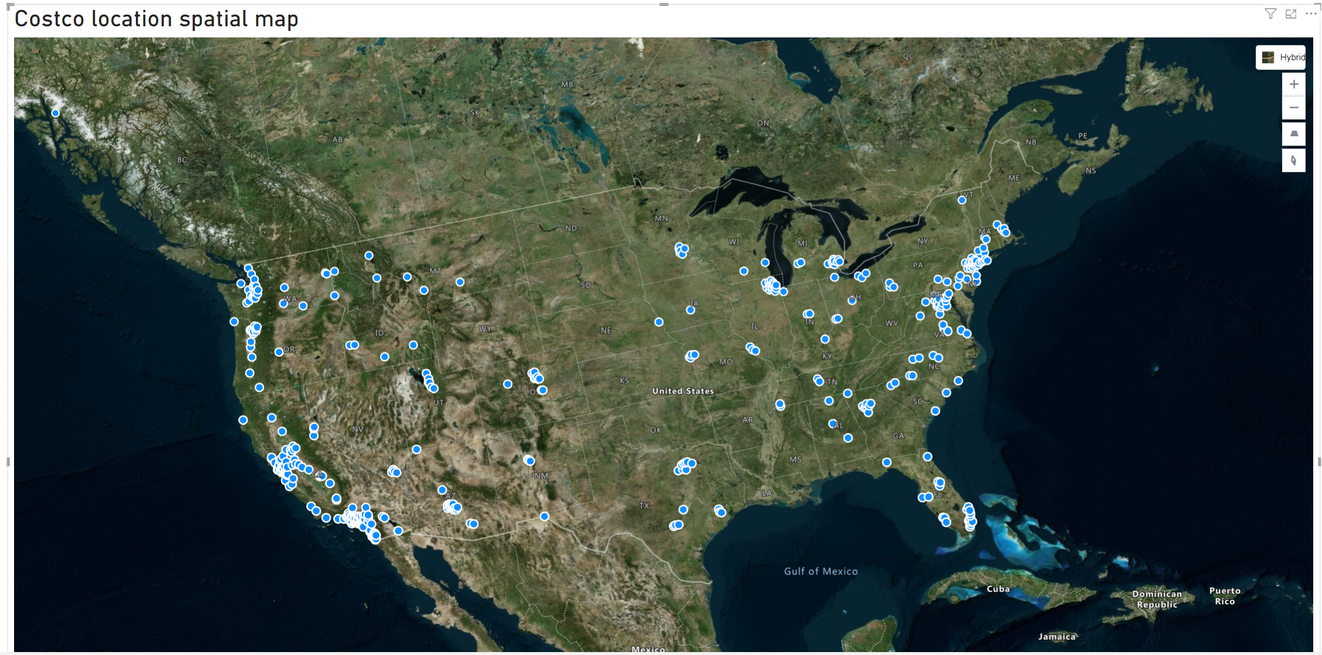
Costco Spatial Map

Slide 4
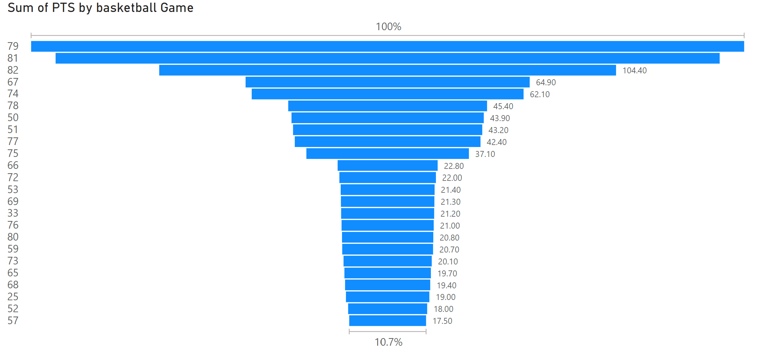
Power BI Funnel Chart

Slide 5
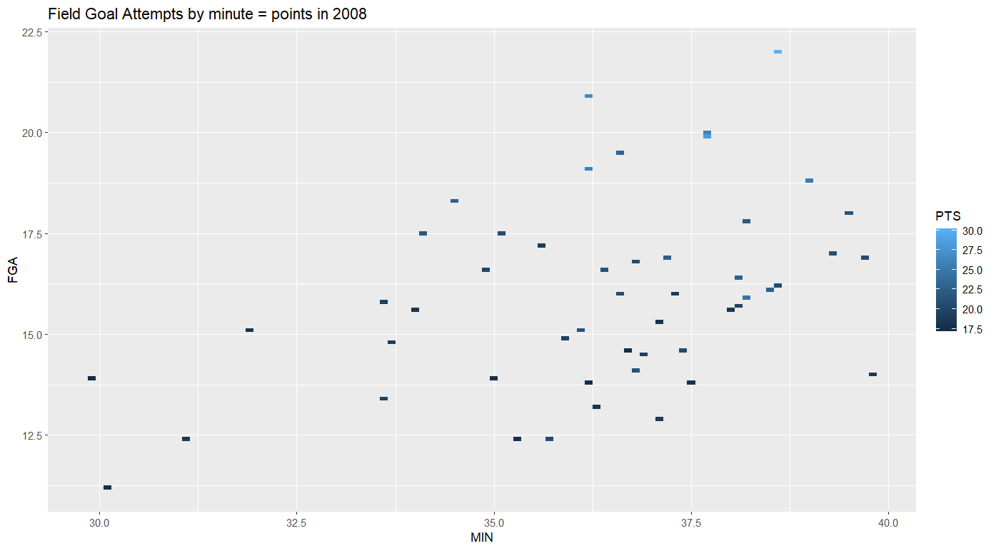
R Heat Map
ggplot(Points, aes(x = MIN, y = FGA, fill = PTS)) + geom_tile()+ ggtitle("Field Goal Attempts by minute = points in 2008")

Slide 6
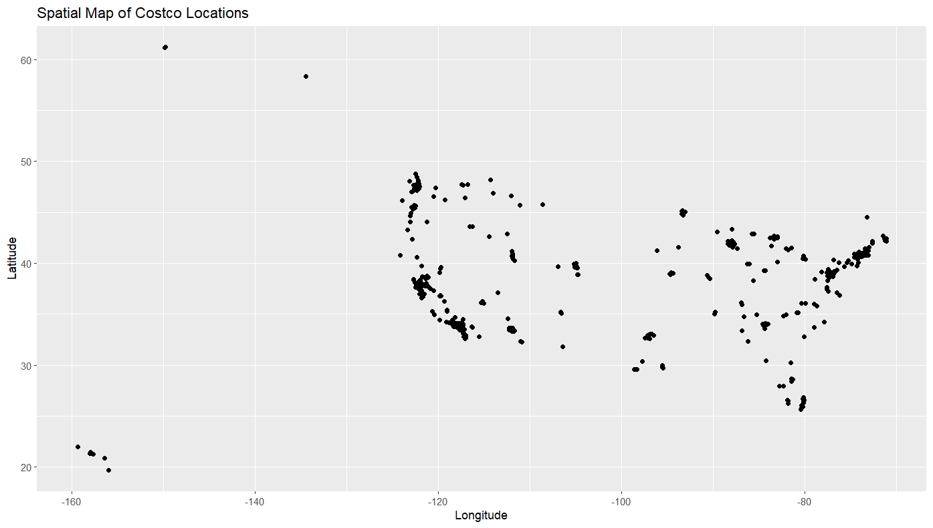
R Spatial Map
Costco %>% ggplot(aes(x = Longitude, y = Latitude))+ geom_point()+ labs(title = "Spatial Map of Costco Locations")

Slide 7
R Contour Chart
x<-Points['G']y<-Points['PTS']z<- kde2d(x, y, n = 50) contour(x, y, z)
Couldn’t solve this one

Slide 8
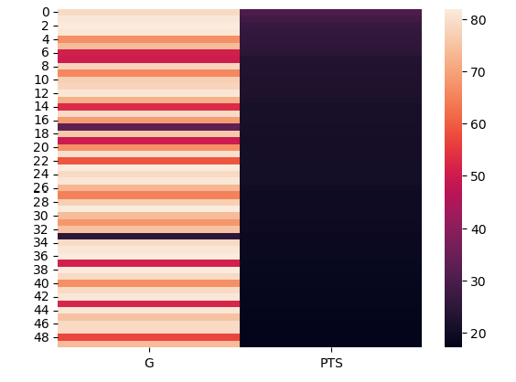
Python Heat Map
P2 = Points.drop(columns=['Name ', 'MIN', 'FGM', 'FGA', 'FGP', 'FTM', 'FTA', 'FTP',
'3PM', '3PA', '3PP', 'ORB', 'DRB', 'TRB', 'AST', 'STL', 'BLK', 'TO',
'PF’])
p1 =sns.heatmap(P2)

Slide 9
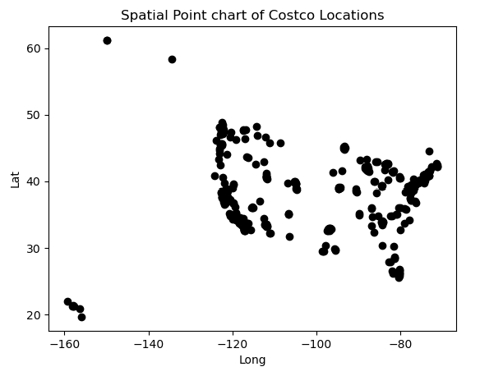
PYTON Spatial Chart
plt.plot(Costco['Longitude'], Costco['Latitude'], 'o', color='black');
plt.title('Spatial Point chart of Costco Locations')
plt.xlabel('Long')
plt.ylabel('Lat')
plt.show()

Slide 10
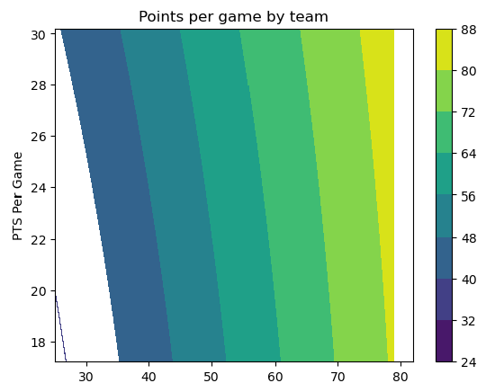
PYTHON Contour Chart
import numpy as np
import matplotlib.pyplot as plt
xlist = Points['G']
ylist = Points['PTS']
X, Y = np.meshgrid(xlist, ylist)
Z = np.sqrt(X**2 + Y**2)
fig,ax=plt.subplots(1,1)
cp = ax.contourf(X, Y, Z)
fig.colorbar(cp) # Add a colorbar to a plot
ax.set_title('Points per game by team')
#ax.set_xlabel('x (cm)')
ax.set_ylabel('PTS Per Game')
plt.show()

